Slide 1
JSON Data Modeling
Matthew D. Groves | DevRel Engineer
October 2023

Slide 2
Modeling Data in a Relational World
RDBMS table-based modeling
Contacts
Billing
Customer
Purchases
Connections
Notes:
Most developers are probably already familiar with the relational way of modeling data
But if you want the benefits of a non-relational database, you have to think differently about modeling
Fortunately, Couchbase gives you the familiar tools of SQL, as we'll see today

Slide 3
Agenda
01/
Why NoSQL?
02/
JSON Data Modeling
03/
Accessing Data
04/
Examples
05/
Summary / Q&A
Notes:
Spend just a little time on why people are using NoSQL
Talk about how data is modeled differently in JSON
Talk about accessing data, since that has an effect on modeling
Have some examples we’ll work through to highlight tradeoffs / decisions

Slide 4
Why NoSQL?
1

Slide 5
NoSQL Landscape
Broad categories, many are "multi-model"
Couchbase
DynamoDB
CosmosDB
Redis
Aerospike
Key-Value
Couchbase
MongoDB
DynamoDB
CosmosDB
Document
Cassandra
Hbase
CosmosDB
Datastax
Wide Column
Neo4J
OrientDB
CosmosDB
Graph
🔑
📄
🔢
🗺
Notes:
Let’s talk about what NoSQL is, first.
NoSQL generally refers to databases which lack SQL or don’t use a relational model
Once the SQL language, transaction became optional, flurry of databases were created using distinct approaches for common use-cases.
KEY-Value simply provided quick access to data for a given KEY.
Wide Column databases can store large number of arbitrary columns in each row
Graph databases store data and relationships as first class concepts
Document databases aggregate data into a hierarchical structure.
With JSON is a means to the end. Document databases provide flexible schema,built-in data types, rich structure, implicit relationships using JSON.

Slide 6
NoSQL Landscape
Broad categories, many are "multi-model"
Couchbase
MongoDB
DynamoDB
CosmosDB
Document
📄
Get by key
Set by key
Replace by key
Delete by key
Store data as JSON (or XML, etc)
Query/index
Notes:
Document databases typically means that in the early days, and as a baseline
you can expect an API like this
What sets document apart from key-value store is the last two
Minimal set of APIs and features
As you get into specific vendors and as databases continue to mature, there are many more features being added
And generally I’m seeing a convergent trend between relational and NoSQL
This set of minimal features, lacking a SQL language and tables gives us the buzzword “nosql”

Slide 7
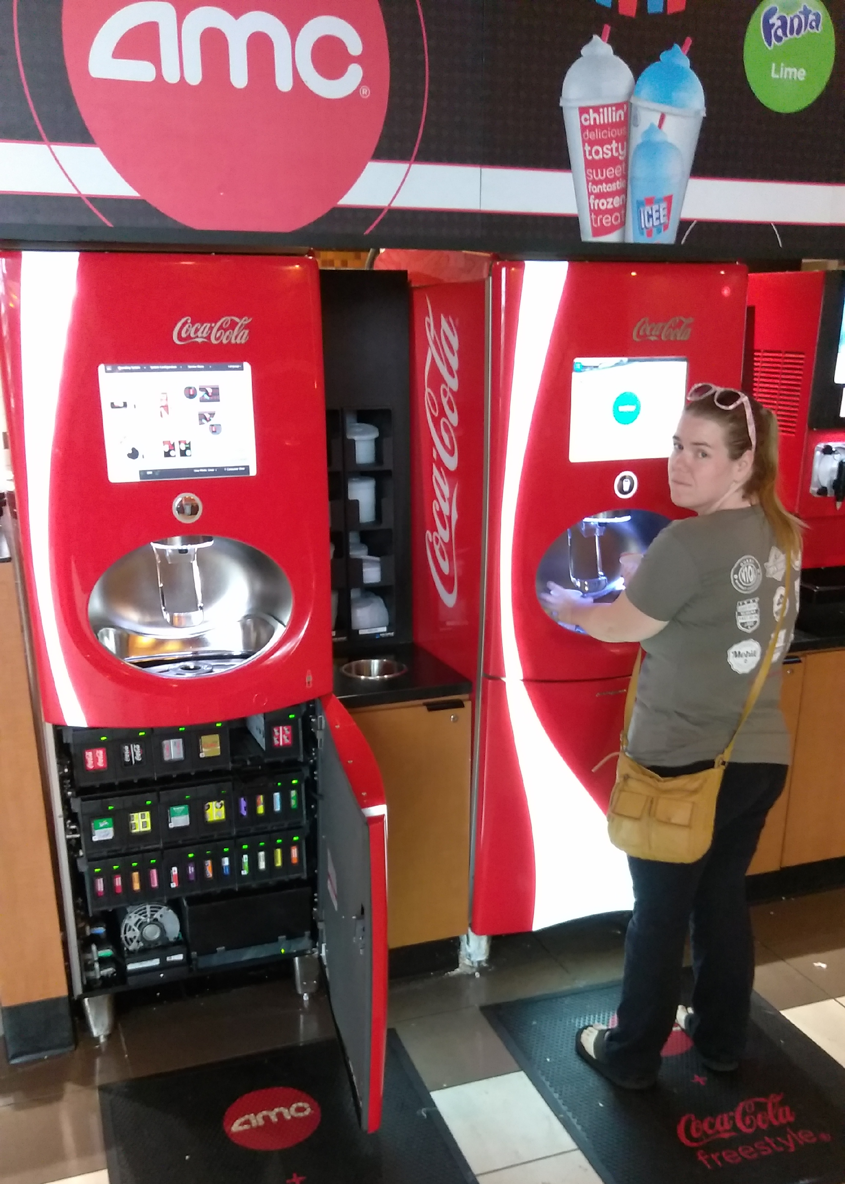
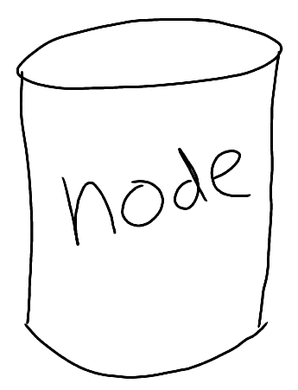


Why NoSQL?
Notes:
Scalability – horizontal, specifically
Availability – five nines, upgrade/patch at a decent hour
Speed – Access patterns, memory usage, or other optimizations
Flexibility – less constrained that relational data
The “why” is important, and will affect modeling to an extent.
Cost of ownership – maybe not something developers think about too much, and I'm not going to go into very much today, but certainly that's important to us here at Couchbase too
All of these characteristics go hand-in-hand
But I want to focus on flexibility today, that's what's most interesting from a data modeling perspective

Slide 8
RDBMS Example | User Profile
User Info
Address Info
KEY
First
Last
ZIP_id
ZIP_id
CITY
STATE
ZIP
1
Frank
Weigel
2
1
DEN
CO
30303
2
Ali
Dodson
2
2
MV
CA
94040
3
Mark
Azad
2
3
CHI
IL
60609
4
Steve
Yen
3
4
NY
NY
10010
To get information about specific user, you perform a join across two tables
Notes:
Example of relational data modeling
Of which we're all familiar
This is an example of two tables, and to get that address info for a user, you need a join

Slide 9
Denormalization with JSON
User Info
Address Info
KEY
First
Last
ZIP_id
ZIP_id
CITY
STATE
ZIP
{ "ID": 1, "FIRST": "Frank", "LAST": "Weigel", "ZIP": "94040", "CITY": "MV",
"STATE": "CA" }
=
1
Frank
Weigel
2
+
1
DEN
CO
30303
2
Ali
Dodson
2
2
MV
CA
94040
3
Mark
Azad
2
3
CHI
IL
60609
JSON
4
Steve
Yen
3
4
NY
NY
10010
With Document model, data can be stored in a single JSON document
Notes:
With JSON modeling, this data can be combined into one document
Why combine? Let's go back to those 4 whys
Scaling – If data can be more independent, then it can be more easily stored on multiple nodes
Availability – When there are multiple nodes, there can be backup replicas for a quick recovery
Speed – in this case, a SQL JOIN query is replaced by a faster GET operation, can be even faster if the database has a cache
What about flexibility?

Slide 10
Making a Change Using RDBMS can be complex
User Table
Photo Table
Country Table
User ID | First | Last | Zip | Country ID
1 | Frank | Wiegel | 94040 | 001
2 | Joe | Smith | 94040 | 001
3 | Ali | Dodson | 94040 | 001
4 | Sarah | Gorin | NW1 | 002
5 | Bob | Young | 30303 | 001
6 | Nancy | Baker | 10010 | 001
7 | Ray | Jones | 31311 | 001
8 | Lee | Chen | V5V3M | 008
… |  |  |  | …
50000 | Doug | Moore | 04252 | 001
50001 | Mary | White | SW195 | 002
50002 | Lisa | Clark | 12425 | 001
User ID | Photo ID | Comment | Country ID
2 | d043 | NYC | 001
2 | b054 | Bday | 007
5 | c036 | Miami | 001
7 | d072 | Sunset | 133
5002 | e086 | Spain | 133
Country ID | Country name
001 | USA
002 | UK
003 | Argentina
004 | Australia
005 | Aruba
006 | Austria
007 | Brazil
008 | Canada
009 | Chile
…
130 | Portugal
131 | Romania
132 | Russia
133 | Spain
134 | Sweden
Status Table
User ID | Status ID | Text | Country ID
1 | a42 | At conf | 134
4 | b26 | excited | 007
5 | c32 | hockey | 008
12 | d83 | Go A’s | 001
5000 | e34 | sailing | 005
Affiliations Table
User ID | Affl ID | Affl Name | Country ID
2 | a42 | Cal | 001
4 | b96 | USC | 001
7 | c14 | UW | 001
8 | e22 | Oxford | 002
Notes:
For that, let's look at a broader picture of a relational schema.
Suppose for this schema, I want to add a column, like a country to one or more tables
Adding a new column can often affect availability, could require downtime.
Also, what if country doesn't make sense for every row? Now there's a (usually) empty nullable field

Slide 11
Making the Same Change With a Document Database
{ "ID": 1, "FIRST": "Ahmed", "LAST": "Ali", "ZIP": "94040", "CITY": "MV",
"STATE": "CA",
"STATUS":
{"TEXT": "At Conf",
"GEO_LOC": "134"},
"COUNTRY": "KSA"
}
{ "ID": 1, "FIRST": "Ahmed", "LAST": "Ali", "ZIP": "94040", "CITY": "MV",
"STATE": "CA",
"STATUS":
{"TEXT": "At Conf" }
}
JSON
JSON
Just add information to each document
Notes:
Making this change in a document database
Does not require an ALTER. As a developer, you can just start adding it, or updating existing data.
Does not require every document in a given collection to have a country
This is just a very minor example, but if you extrapolate to a schema with hundreds of tables, and the often changing business requirements, the flexibility benefits can start to stack up.

Slide 12
Use Cases for NoSQL
Caching
Session
User profile
Catalog
Content management
Personalization
Customer 360
IoT
Inventory
Communication
eCommerce / Retail
Advertising
Mobile Sync
Loyalty programs
Fraud monitoring
Offline-first
Finance / Banking
Health Care
Notes:
Highlight mobile/offline first: Mark Gamble presentation earlier today
NoSQL is very versatile and can be used for a wide variety of use cases
Including, but NOT limited to these, I highlighted a few that might be interesting to Carnival
I've been presenting some form of this presentation for 5+ years. This list didn't start with "finance" and "inventory" and "health care" on it
But they are there now, because NoSQL databases, especially Couchbase, are maturing.
Using a NoSQL database does NOT mean you have to abandon relational databases. Most large websites use a combination.
And it's also worth pointing out that plenty of companies are doing (most) of these use cases with relational as well.
Relational is like a safe choice. NoSQL may be BETTER, usually the catalyst is one of the earlier reasons: speed, flexibility, scale, availability
For instance:
* user profile customization, each person is different, and may not fit neatly into the columns you've created
Catalog is the same way, each item at a grocery store may have a few things in common (like UPC code), but many other traits are very different (weight, color, expiration date, etc)
Mobile sync: writing your own mobile sync and/or offline first is very difficult and time consuming

Slide 13
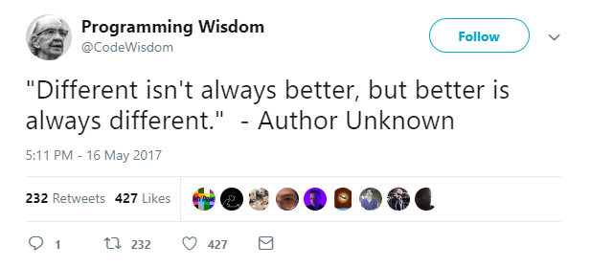
Use Cases

Slide 14
JSON Data Modeling
2

Slide 15

NoSQL Data Model
Scopes and Collections are dynamic, logical containers within a Bucket
Bucket:
‘Travel’
The way your data organization is modelled influences:
Mapping from a relational data model
Access Control granularity
Queries and indexes design and performance
Multi-tenancy TCO and isolation
Replication between clusters design
Scope: ‘Booking’
Scope:
‘Payment’
Collection: ‘Airline’
Collection: ‘Booking’
Collection: ‘Hotel’
Collection: ‘User’
Collection:
‘Airport’
Collection: ‘Refund’
Collection:
‘Route’
Notes:
NoSQL databases don't have tables, what DO they have?
This can vary, but often times you'll at least see a "collection" (Couchbase, Mongo, Cosmos)
Collections may belong to something like a "scope", next level up (Couchbase)
And then scopes may belong to another level up, (Couchbase = bucket)
---
Data organization can have an impact beyond data modeling,
Including access control, queries/indexes, multi-tenancy, replication

Slide 16
Mapping RDBMS to NoSQL
You can map your relational model to Couchbase model…
Relational | Couchbase
Server | Cluster
Database | Bucket
Schema | Scope
Table | Collection
Row | Document
Primary Key | Document Key
14
Notes:
Here's a "translation" guide from relational to NoSQL
It doesn't mean these are the same things, but it may help you
To understand the organization level of the various terms

Slide 17
Data Modelling Approaches
Relational data model
Document data model
Required Normalization
Schema enforced by the database
Same fields required in all records
Relaxed Normalization
Schema inferred from structure
Fields may vary, be duplicate or missing
Optimized for data entry
Reduced duplicated data
Minimize data inconsistencies
Optimized based on access patterns
Flexible and agile development
Supports clustered, scalable architecture
Notes:
I'm not here to tell you that JSON data modeling is superior to relational
There are tradeoffs
RDBMS *requires* normalization, requires ALTER, and there are benefits to this
But the tradeoffs are that it's difficult (note I didn't say impossible) but DIFFICULT to get those 4 things: availability, performance, scalability, flexibility
And with a JSON database, you can still have normalization if you choose, but it's "relaxed", not enforced by the database
So what we want to accomplish with modeling is:
Optimize the modeling based on access patterns, not 3NF relational structure
Flexible, ability to respond to change (one of the tenets of agile)
Clustered/scalable (which is not IMPOSSIBLE with relational, but as Brant said "You hate your life")

Slide 18
Using JSON to Store Data
Customer Document Key: CBL2017
{
"Name" : "Jane Smith",
"DOB" : "1990-01-30”
}
Customer
CustomerID
Name
DoB
OR
CBL2017
Jane Smith
1990-01-30
Customer Document Key: CBL2017
{
"Name" : {
"fname": "Jane",
"lname": "Smith"
}
"DOB" : "1990-01-30"
}
The Primary Key becomes the Document Key
Column name-Column value become KEY-VALUE pair
Notes:
So let's just go through an example, relational on the left, document on the right
And already, we got options and decisions to make
If you aren't comfortable making decisions, JSON modeling may not be for you
BUT
Remember that unlike relational, decisions are more easily reversed.

Slide 19
Using JSON to Store Data
Customer
Customer Document Key: CBL2017
CustomerID
Name
DoB
{
"Name" : "Jane Smith",
"DOB" : "1990-01-30",
"Billing" : [
{
"type" : "visa",
"cardnum" : "5827-2842-2847-3222",
"expiry" : "2025-03"
},
{
"type" : "master",
"cardnum" : "6274-2542-5847-3949",
"expiry" : "2024-12"
}
]
}
CBL2017
Jane Smith
1990-01-30
Billing
CustomerID
Type
CardNum
Expiry
CBL2017
Visa
5827-2842-2847-3222
2025-03
CBL2017
Master
6274-2542-5847-3949
2024-12
Denormalization simplifies data access, possibly better performance
Value evolution: Simply add additional array element or update a value
22
Notes:
Okay let's bring in a second table
Usually done with foreign keys
A single customer consists of 3 rows across 2 tables, you need joins.
In a JSON model, one way we could model it is to embed the billing data into an array
So it remains a single document.
If you have a use case where your data access consists of querying customer joined with billing
And maybe there's an O/RM involved (Hibernate or EF or Active Record or whatever)
And that happens a lot, then this will lead to better performance.

Slide 20
RDBMS tables to Collections mapping | eCommerce example
Bucket: ecommerce | Scope:_default
Orders
id | 200
customer | 40
status | Paid
{
"name": "T-shirt",
"description": "Red Couchbase T-shirt",
"image": "tshirt_red.jpg"
}
DocID:1
Collection: ‘Products’
Customers
id | 40
name | Jane Smith
email | jane@couchbase.com
address | 11-21 Paul Street
city | London
postcode | EC2Q 4JU
telephone | 44-20-3837-9130
{
"name": "Jane Smith",
"email": "jane@couchbase.com",
"address": "11-21 Paul Street",
"city": "London",
"postCode": "EC2A 4JU",
"telephone": "44-20-3837-9130"
}
DocID:40
Orders Details
id | 3000
order | 200
item | 1
quantity | 3
Collection: ‘Customers’
{
"customer": {
"id": 40,
"name": "Jane smith",
"email": "jane@couchbase.com"
},
"status":"Paid",
"orderDetails": [
{ "productId" : 1, "name": "T-shirt","quantity": 3},
]
}
DocID:200
Products
id | 1
name | T-shirt
description | Red Couchbase T-shirt
image | tshirt_red.jpg
Collection: ‘Orders’
23
Notes:
Finally, let's bring Orders, Orders Details, and Products
In the JSON database, there can be a customers collection, products collection, orders collection
And again back to decision time, do you want to embed those "Orders Details" into an Order document?
Could be better performance as well as more flexibility (does every order have a quantity?)

Slide 21




Making Trade-offs
Data Modelling trade-offs are necessary when dealing with Distributed Systems
Impact on disk space
Impact on time to transfer across the network
Impact on time to serialize/deserialize
Impact on queries (e.g. JOIN slower than lookups)
Transactions provide ACID guarantees across multiple documents
Transactions are slower than atomic KV operations at the document level
Simple data models are easier to maintain
Complex data models lead to complex (and slower) queries and indexes
Smaller collections increase indexing performances
Performance depends on documents size, complexity of the queries and resources available - compute, storage and network
Optimize data model for the most used queries
Document Size
Atomicity
Complexity
Speed
Notes:
I'm going to go through a few more examples later
To try and help you understand the tradeoffs and possible decision
But data modeling is all about tradeoffs
Consolidating data into a document – means the data could get bigger
Atomicity – if you consolidate, you have less need of an ACID transaction, if you don't or can't, transactions are overhead, especially in distributed
Complexity – More normalization, more collections, small collections can have indexing benefits
Speed – document size is one factor (more on that later), optimizing for ACCESS PATTERNS

Slide 22


Document Size
Large fully denormalized documents are not the ultimate answer
JSON Document size is limited to 2-20 MB range
Larger documents take more disk space, more time to transfer across the network and more time to serialize/deserialize
If you are dealing with documents that are potentially large (greater than 1 MB), you must test thoroughly to find out if speed of access is adequate as you scale. If not, you will need to break up the document into smaller ones.
> 1MB
Notes:
For NoSQL databases, a single document is limited
Cosmos is 2mb (possibly more if you're using a different API), mongo is 16, Couchbase is 20
The point isn't the actual cap, it's that large, consolidated documents have tradeoffs
If the size proves to be a bottleneck, break them up
OR, depending on which document database you’re using, there may be other options (more on that later)
We’ll talk about that in the “accessing data” section

Slide 23


Embed vs Refer | General Considerations
EMBED WHEN
REFER WHEN
There is an Ownership Relationship
Both docs are frequently accessed together
Reads greatly outnumber writes
Data is small
There is not an Ownership Relationship
Both docs are not frequently accessed together
Document is updated frequently
Need to reduce the document size
Try to embed first, refer when it makes sense
Notes:
And speaking of breaking them up,
Another decision exists when it comes to relationships.
Embed vs Refer.
In the relational world, it's always refer. Foreign keys, separate tables.
In the JSON DB world, you can choose.
Here are some tips to help you decide which way to go.
For each of these, not all may apply to every situation.
Embed when: A "owns" B, A+B are often accessed together, mostly reads, and the combined data is relatively small
Refer when: A is related but doesn't "own" B (aggregate root concept from DDD), both docs are often accessed separately, there are often writes, or doc size needs reduced
My recommendation if you're in doubt: try embed/consolidate first.

Slide 24
Embed vs Refer | Relationships
1-1
Embed Example: Satellite and Manufacturer
1-Many
Embed Example: Satellite and Missions
Reference Example: Measurements, Satellites and Instruments
Many-Many
Reference Example: Satellite and Instruments
Satellites
Instruments
{
"name":…,
"route":…,
"missions":[
{"name":"launch",
"date":…},
{"name":"repair-1",
"date":…}
],
"instruments":[
{"id":"camera_01"},
{"id":"altimeter_01"},
…
],
"manufacturer":{
"name":"Boeing",
"city":"Seattle",
…
}
}
{
"id":"camera_01",
"manufacturer":{
"name":"Boeing",
"city":"Seattle",
…
}
}
Missions
Measurements
Instruments
{
"instrument_id":"altimeter_01",
"satellite_name":…,
"date_time":…,
"location":{
{"lat":…, "long":…},
"measurement":…,
…
}
}
Manufacturer
27
Notes:
Here's a model to demonstrate some of the relationships you'll need to think about
Satellites, which are made up of missions, instruments, and manufacturer
The Satellites take measurements, and they use instruments to do this.
1-to-1 – In this case, it's embedded (sat and mfg)
1-to-many – also embedded. This might be an issue if a "mission" would involve multiple satellites, but the decision made
With this model is that satellites "own" missions
Many-to-many – it definitely makes sense to have these separate, satellites can contain multiple instruments
And satellites will have multiple measurements
And like the relational world, there's a many-to-many collection of measurements that link them

Slide 25
Versioning approach 1: Version Numbers
Document Key: 120902
Document Key: 930912
{
"firstName" : "jeff",
"lastName" : "morris",
"version" : 2
}
{
"name" : "matt groves"
"version" : 1
}
Notes:
Before moving on to “accessing data” and its effect on modeling…
You can use a simple number, or more complex data
And then you’ll have this information in your application that you can
Switch on to determine how to proceed

Slide 26
Versioning approach 2: Big Bang Re-versioning
Document Key: 120902
Document Key: 120902
{
"firstName" : "matt",
"lastName" : "groves
}
{
"name" : "matt groves"
}
Notes:
The next approach is to just change everything to the new model.
A big "UPDATE", or a series of batch updates.
This is basically the relational approach, except no downtime required.

Slide 27
Versioning approach 3: "Strangler Fig"?
DocumentKey: 120902
Web application
{
"name" : "matt groves"
}
DocumentKey: 120902
{
"firstName" : "matt",
"lastName" : "groves",
}
Notes:
"Cooperative Re-versioning“ or “Ship of Theseus”
A web application (let's say) accesses a piece of data in the course of normal operations
BUT
While we're at it, let's change this to the new format
So, as people login and use the system, the data gets re-versioned to the new model gradually.
You can *kinda* take this approach with relational, but it gets messy, because you'll end up with a "name", "firstName", and "lastName" column in the same table and a lot of NULLs. Which I'm sure no one's ever seen before. In a document database, you don't need a bunch of nulls hanging around. You can split name into first/last and then ditch name on a per-document basis.
---
You can use any of these 3 approaches, none of them, or all of them together, or maybe there's a better approach I don't know of.

Slide 28


Modeling tools
Hackolade
Erwin DM NoSQL
https://jsoneditoronline.org
Notes:
Hackolade supports couchbase, and many other NoSQL tools
Erwin supports couchbase
Json editor online is also a free, no-frills offering that can help you with modeling, diffing, and such

Slide 29
Accessing Data
3
Notes:
The way you plan to get data out can also affect the way you model your data
With relational, you really only have one way to access data: a SQL query
With NoSQL databases, you have multiple ways to access data (including SQL, ironically)

Slide 30
Key-Value API | CRUD operations
key
user::1
C
R
U
D
userCollection.insert("user::1",doc1)
{ "ID": 1, "FIRST": "Frank", "LAST": "Weigel", "ZIP": "94040", "CITY": “MV",
"STATE": "CA" }
userCollection.get("user::1")
Value
userCollection.replace("user::1",doc1)
JSON
userCollection.remove(doc1)
Notes:
One of the things that's key to understanding the difference
In modeling relational and modeling JSON
Is that when accessing relational data, you only have one option: SQL
With a JSON database, you have multiple options (including, in some cases, SQL)
But every JSON database will have CRUD operations available
Perform operations based on the KEY
These code examples are JavaScript, but of course popular JSON
Databases should have SDKs for every popular language: Java, .NET, Ruby, PHP, Go, etc

Slide 31
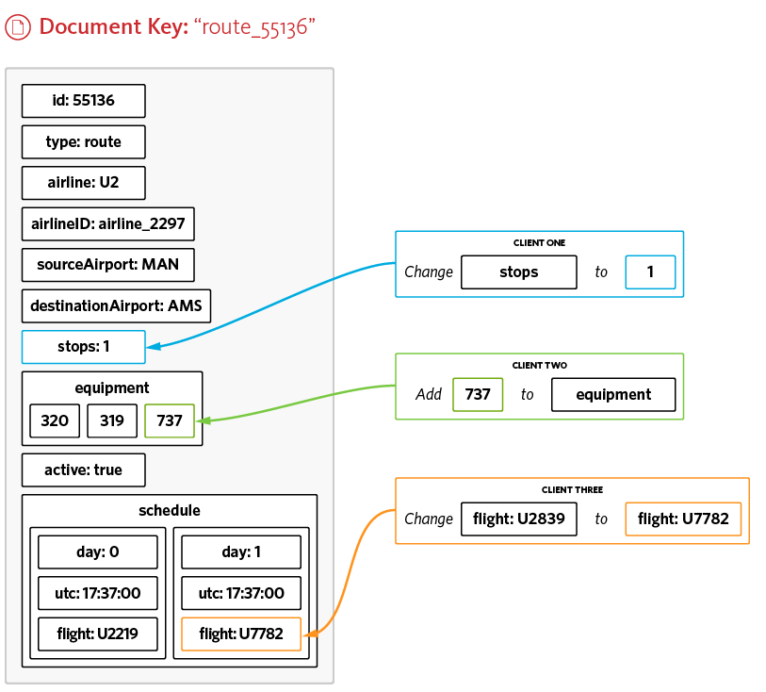
Key-Value API | Sub-Document API
route::55136
Atomically update and retrieve parts of a document.
Via providing a path to individual fields - including arrays
More efficient use of network bandwidth than fetching entire documents
Notes:
Remember earlier when we discussed document size being an issue
If you're modeling and you can't or don't want to split up a document
There is another approach that can help with performance
It goes by different names depending on the database
But I'm calling it "subdocument API" because that's what Couchbase calls it
With this API, you can operate on PARTS of the document
Without sending the whole thing back and forth over the wire
Just want to change a user's status from "subscribed" to "unsubscribed"
Instead of getting the whole user profile, you just get and set one JSON field

Slide 32
SQL++ | Queries Examples
SELECT *
FROM `travel-sample`.inventory.route
WHERE airline="KL"
AND sourceairport="ABQ"
AND destinationairport="ATL"
AND ANY departure IN schedule SATISFIES departure.utc > "23:40" END;
SELECT t1.country,
array_agg(t1.city),
sum(t1.city_cnt) as apnum
FROM
(SELECT city,
city_cnt,
array_agg(airportname) as apnames,
country
FROM `travel-sample`.inventory.airport
GROUP BY city,
country LETTING city_cnt = count(city)
) AS t1
WHERE t1.city_cnt > 5
GROUP BY t1.country;
SQL++ query with Arrays
CREATE FUNCTION locations(vActivity) {
(SELECT id, name, address, city
FROM `travel-sample`.inventory.landmark
WHERE activity = vActivity) };
SELECT l.name, l.city
FROM locations("eat") AS l
WHERE l.city = "Gillingham";
SQL++ query with Subquery
SQL++ query with User Defined Function
Notes:
I mentioned earlier that relational's only tool is SQL
You may have heard that "NoSQL" stands for "not only SQL"
And I believe for some JSON databases, that's actually true
Couchbase, for instance, has a full ANSI compliant SQL implementation called SQL++
CosmosDB and DynamoDB also have SQL implementations, although they are not yet full implementations (no JOINs, for instance)
SQL++ is powerful in it's flexibility, declarative nature, familiar to developers, JOINs, etc.
But note, once we step out of key/value access, we need to involve other processes:
We gotta parse the query, most likely use an index service, and in the end we'll get a bunch of keys to lookup the data.
There is overhead involved, but sometimes this is a necessity.
Also note that many JSON NoSQL databases have their own non-SQL query language.
These language can achieve similar things, but I'm a huge fan of the expressiveness and
Power of SQL as a language. But note that things like MQL (mongo/cosmos) and Dynamo API provide similar functionality here

Slide 33
Key/Value or SQL++ | Expressivity Comparison
Key Value API
Query API
PREREQUISITES
Require the Document Key
Require Indexes Primary, Secondary, Filtered, Covering, On Array, Adaptive, Flex
OPERATIONS
CRUD Operations
Sub-Document Operations
Atomic Counters
TTL at the bucket, collection or document level
Statements
SELECT FROM WHERE GROUP BY HAVING ORDER BY OFFSET LIMIT
UNION, INTERCEPT, EXCEPT
INSERT, DELETE, UPDATE, MERGE
Operators: Arithmetic, Collection, Comparison, Conditional, Logical, Nested, String
Support for ANSI JOINS and Nested Queries
Extension to Arrays, Nested Objects
Support for Window Function and CTE
Built-in or User Defined functions (incl. Javascript)
TRANSACTIONS
Support for Insert, Update, and Delete across multiple documents, buckets and collections
Support for INSERT, UPSERT, DELETE, UPDATE, MERGE, SELECT
Support for Transactional constructs: BEGIN, SET, ROLLBACK, COMMIT, SAVEPOINT
Notes:
This is a side-by-side that breaks down what each of these APIs can
Do, and what they should be used for
KV API is simple, fast
Query API is more flexible, but requires indexing, parsing, overhead
FTS is ideal for text-based or geospatial-based search, but again indexing, parsing, overhead

Slide 34


Key/Value or SQL++ | Architecture Comparison
SELECT …
FROM …
WHERE …;
get(key)
Direct access to the node where the document resides
Receive document
Submit query
Get results
Query Service
Parse
Plan
Scan
Fetch
Join
Filter
Pre-Agg
Agg.
Sort
Offset
Limit
Project
In case of cache hit, direct access from memory
Data Service
Scan indexes
Fetch data (optional)
Index Service
Search Service
Data Service
In case of cache miss, access to disk and populate the cache in memory
Data Service can process CRUD read and write traffic with sub-millisecond latency
A Query Service is designed to allow more expressive and flexible queries
Notes:
Some more detail on the overhead involved
Key value can go directly to the data service (in the case of Couchbase, it will go directly to the node that the data is on, Couchbase keeps a copy of the cluster map stored client side)
For a query, there is the normal steps of query parsing, execution (depending on the complexity of query, may involve sorting, aggregation, offset, limit, etc), index usage, and then *probably* the data service

Slide 35
Key/Value or SQL++ | Performances Comparison
Couchbase API | Latency | Performance Key Factors | Use Cases
Key-Value | µs to ms | Amount of data in memory Document size Workload Isolation Disk speed Network latency | Best for high throughput, latency sensitive workloads
Query | ms to sec | Data model Indexes Query complexity Workload Isolation Network latency | Best for secondary lookups, pushing logic to database
SQL++ provides the highest expressiveness while KV operations are the fastest way to access documents.
Pick the best fit for your use cases - and you can also combine both services.

Slide 36
Travel Sample Example
Collection: 'airline'
Collection: ‘route’
{
"id": "5966",
"type": "route", "airline": "AA",
"airlineid": "airline_24",
"sourceairport": "MCO",
"destinationairport": "SEA",
"stops": "0",
"schedule": [
{"day": 1, "utc": "13:25:00", "flight": "AA788"},
{"day": 4, "utc": "13:25:00", "flight": "AA419"},
{"day": 5, "utc": "13:25:00", "flight": "AA519"}
]
}
{
"id": 24,
"type": "airline",
"name": "American Airlines",
"iata": "AA",
"icao": "AAL",
"callsign": "AMERICAN",
"country": "United States"
}
route_5966
airline_24
Collection: 'airport'
{
"id": 3577,
"type": "airport",
"airportname": "Seattle Tacoma Intl",
"city": "Seattle",
"country": "United States",
"faa": "SEA",
"icao": "KSEA",
"tz": "America/Los_Angeles",
"geo": {
"lat": 47.449,
"lon": -122.309306,
"alt": 433
}
}
Collection: 'hotel'
airport_3577
{
"id": 10180,
"type": "hotel",
"name": "Bacara Resort Spa",
"address": "8301 Hollister Ave",
"city": "Santa Barbara",
"country": "United States",
"description": "Located on 78 acres of oceanfront...",
"price": "$300-$1000+",
"url": "http://www.bacararesort.com/",
"reviews": [...]
}
hotel_10180
Bucket travel-sample, scope inventory
Notes:
Let's go through some examples of data access
Here's some Travel Sample data, which comes with Couchbase out of the box
Airlines, which have routes, routes start and end at airports.
There's also Hotels, which don't have a direct relationship with the others.
These are all in their own collections

Slide 37
Replacing Query with Key-Value | Basic Use Cases
Query a document, by key
KV Lookup
SELECT *
FROM airport
WHERE id = 3577;
GetResult getResult =
airportCollection.get("airport_3577");
Query a subset of fields
KV LookupIn
SELECT airportname, city
FROM airport
WHERE id = 3577;
List<LookupInSpec> spec = Arrays.asList(
LookupInSpec.get("airportname"),
LookupInSpec.get("city")
);
airportCollection.lookupIn("airport_3577",spec);
To get the best performance, use the key-value API if the document key is known
Also consider denormalization on the critical path of your use case
Notes:
Suppose we wanted to get an airport by key
You COULD write a SQL query to do this, but it's going to invoke
All the overhead I showed before.
Instead, replace with a KV operation, which bypasses the query engine and goes directly to the data.
Similarly, instead of SELECT *,
You could also do a Subdocument API (this example is Java, but it's similar for other languages)

Slide 38
Key/Value: Recommendations for keys
Natural Keys
Account number, driver license number, ISBN
Human Readable
"user-123" vs "0be12ae9-1b1d-4724-9706-2977cc134daf"
Deterministic
"matt" -> "matt::blogs" -> "blog::csharp_9_features"
Semantic
Notes:
Since key/value is so fast and easy, it would benefit us to use it as much as possible.
Here are some tips to maximize your key/value usage.
This applies no matter which key/value lookup database you're using.
Though with something like Couchbase, you can also use scopes and collections to better organize your data instead.

Slide 39
Other ways to access data (Couchbase)
Key-Value
(CRUD)
SQL++
(SQL Query)
Full Text (Search)
Mobile
(iOS/ Android)
Analytics
(Query)
Indexes
Indexes
Sync Gateway
SQL++
Documents
Notes:
I've mostly been talking about key/value access and SQL
Most NoSQL databases will have at least one other way to access data besides key/value.
What does this have to do with modeling? Because modeling doesn't exist in a vacuum. You have to think about how you are going to interact with your data.
There are other options I'm not going to cover today
Including search, mobile sync, analytics
They are all different ways to access the same pool of data.
The key is to make sure you're using the optimal method to do what you want.
Key-value is fast, yes, but it's not as flexible as SQL. And SQL can help you search
but for text search, it's not as full featured as Full Text Search. Etc.

Slide 40
Examples
4

Slide 41
id: "00011b74"
{
"created" : "2014-11-21",
"name" : "Morgan's playlist",
"owner" : "18695",
"tracks" : [
"dQw4w9WgXcQ",
"FL0bcDCE6bg",
"PQHPYelqr0E"
]
}
id: "18695"
{
"name" : "Morgan Freeman",
"address" : {
"street" : "123 Shawshank"
"state" : "OH"
}
}
id: "dQw4w9WgXcQ"
{
"title" : "Never Gonna Give You Up",
"artist" : "Rick Astley",
"mp3" : "https://cdn.example.org/dQw4w9WgXcQ.mp3"
}
Potential Benefits
Speed: Owner name, tracks are separate lookups (playlist document size is small)
Queryability: Consistency is ensured, no embedded copies
Potential Issues
Consistency: Updates to the track will update every playlist (no snapshot)
Multiple look-ups: higher latency compared to a single lookup
Notes:
These documents would be in their own collections

Slide 42
id: "00011b74"
{
"created" : "2014-11-21",
"name" : "Morgan's playlist",
"owner" : {
"id" : "18695",
"name" : "Morgan Freeman"
},
"tracks" : [
"dQw4w9WgXcQ" . . .
]
}
id: "18695"
{
"name" : "Morgan Freeman",
"address" : {
"street" : "123 Shawshank"
"state" : "OH"
}
}
id: "dQw4w9WgXcQ"
{
"title" : "Never Gonna Give You Up",
"artist" : "Rick Astley",
"mp3" : "https://cdn.example.org/dQw4w9WgXcQ.mp3"
}
Potential Benefits
Speed: Faster lookup time for embedded information
Queryability: A single lookup for playlist & owner information
Potential Issues
Speed: Increased document size
Consistency: Changes in user document need to be reflected in multiple other documents
Multiple look-ups: May still be required
Notes:
Now we're denormalizing, copying some data from the user document into the playlist document
Think of it as a "cached copy"
If I often need the owner's name when looking up playlist, this saves a second lookup / JOIN operation

Slide 43
id: "00011b74"
{
"created" : "2014-11-21",
"name" : "Morgan's playlist",
"owner" : {
"id" : "18695",
"name" : "Morgan Freeman",
"address" : {
"street" : "123 Shawshank"
"state" : "OH"
}
},
"tracks" : [
{
"title" : "Never Gonna Give You Up",
"artist" : "Rick Astley",
"mp3" : "https://cdn.example.org/dQw4w9WgXcQ.mp3"
},
{
"title" : "The Game",
"artist" : "Motörhead",
"mp3" : "https://cdn.example.org/FL0bcDCE6bg.mp3"
}, . . .
]
}
Potential Benefits
Speed: A single lookup for everything
Fault tolerance: Less can go wrong
Potential Issues
Document size: Significantly larger. May need a track limitation. (Per-document size limits).
Consistency: Multiple copies of the same data
Queryability: Potential search issues
Notes:
All in one

Slide 44
Summary
5

Slide 45
Summary
Pick the right application
Match data access methods to requirements
Proof of Concept
Notes:
What is the Use Case? What do you think NoSQL will help you with?
Do you need better scaling? Do you need flexibility? Availability?
Do you need to hit certain performance requirements?
---
NoSQL often means there are multiple
Methods to read/write data
Key/value is fastest, but not as flexible
Querying (including SQL) is flexible and familiar
FTS is great for text / geographical / many disjuncts
---
Modeling, Focus, Success Criteria, Review Architecture
consider using a tool like Hackolade to define models rigorously and collaboratively
You can use a tool like the one I'm building in a PoC

Slide 46
Next Steps
Couchbase playground:
https://couchbase.live
Couchbase Capella free trial:
https://cloud.couchbase.com/sign-up
SqlServerToCouchbase:
https://github.com/mgroves/SqlServerToCouchbase

